Slide 1
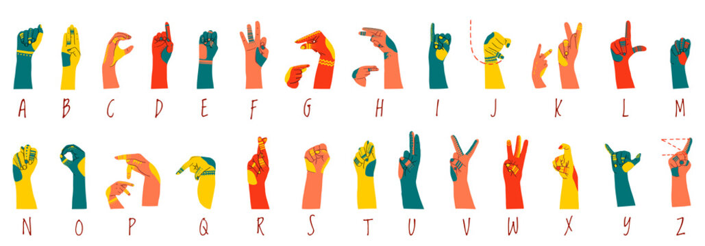
Sign Language Recognition Using CNN
By: Michael Tesis, Robert Mullis
Date: 5/4/2026
AI700-001_BK_Spring 2026

Slide 2
OUTLINES
Title
Outlines
Introduction: Motivation and Problem Definition
Application
Literature Review
Literature Review Results
Algorithm/Approach/Methodology
Dataset Exploration
Model Description
Model Description (Cont.)
Understanding the Functions
Understanding the Functions (Cont.)
Model Hyperparameters
Obtained Results (MNIST Model)
Obtained Results (MNIST Model)
Obtained Results (MNIST Model)
Obtained Results (ASL Alphabet 1000 Images)
Obtained Results (ASL Alphabet 1000 Images)
Obtained Results (ASL Alphabet 1000 Images)
Obtained Results (ASL Alphabet 2000 Images)
Obtained Results (ASL Alphabet 2000 Images)
Obtained Results (ASL Alphabet 2000 Images)
Error Analysis
Comparison to Literature
Future Work
Conclusion
Contribution
References
Questions

Slide 3
INTRODUCTION
Motivation:
Create a practical CNN model capable of recognizing images of Sign Language gestures.
Learn how to apply fundamental Deep Learning concepts in practice.
Make a contribution to the development of SLR.
Demonstrate the performance of the chosen algorithm.
Compare three models that differ by training dataset.
Problem Definition:
From an image containing a Sign Language gesture, we use Sign Language Recognition CNN model to recognize the gesture and output the corresponding English letter.

Slide 4
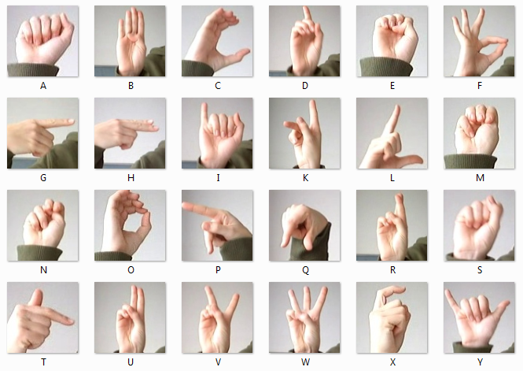
APPLICATION
Application for SLR:
Bridge communication between people who know Sign Language and those who don’t.
Improve communication between people who are hearing impaired.
A technology to learn Sign Language and test your knowledge.
Enable machines to recognize Sign Language in order to control them using gestures.
Facilitate communication in loud environments or places where silence is needed.

Slide 5
LITERATURE REVIEW
Y. Zhang and X. Jiang in their 2024 paper “Recent Advances on Deep Learning for Sign Language Recognition” [7] present a comprehensive and up-to-date analysis of the advancements, challenges, and opportunities in deep learning-based sign language recognition, focusing on the past five years of research.
S. K. Hafiz Muhammad, S. D. Mcloughlin, and I. Murtagh in their 2025 paper “Comparative Evaluation and Utilization of Convolutional Neural Network Architectures for Irish Sign Language Recognition” [8] demonstrate innovative technologies that apply SLR in everyday life. Their research evaluates the performance of different deep neural network architectures in the recognition of sign language.
H. A. Taher and S. R. M. Zeebaree in their 2025 paper “A Critical Study of Recent Deep Learning-Based Continuous Sign Language Recognition” [11] present a comprehensive review of SLR, focusing specifically on Deep Learning techniques. The researchers reviewed 32 studies published by major publishers and examined 12 benchmark datasets related to SLR.

Slide 6
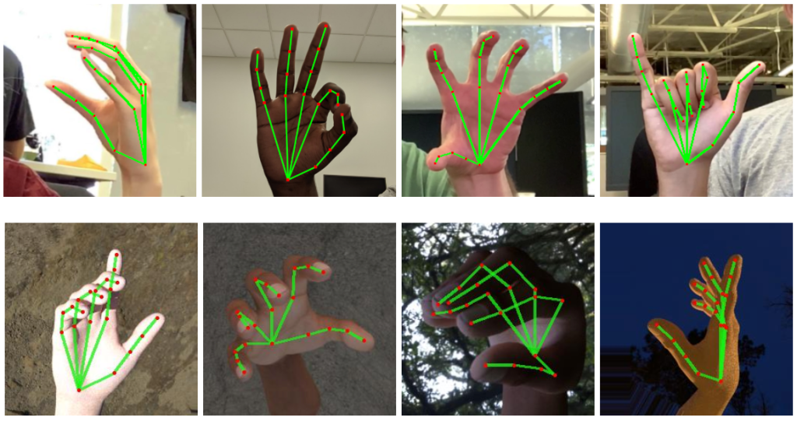
LITERATURE REVIEW RESULTS
Studying the related literature allowed us to:
Understand concept and inner workings of SLR.
Learn the architecture of SLR and all of the steps a CNN model would have to perform for SLR.
Learn different algorithms and techniques that can be used at each step.
Learn the challenges that SLR faces and possible solutions to them.

Slide 7
ALGORITHM/APPROACH/METHODOLOGY
Step 1
Preprocess images before the Input layer by converting to the format of the training dataset.
Step 2
Pad the images by adding pixels around each image in order for the image to retain its size during filtering.
Step 3
Use filters to extract important features out of the images.
Step 4
Reduce the size of the image during pooling to compress the feature map created during filtering.
Step 5
Train the Convolution and Fully-connected layers of the model using backpropagation and different datasets.
Step 6
Test and tune the parameters of the CNN to achieve the optimal accuracy.

Slide 8
DATASET EXPLORATION
We studied the datasets that were used in the papers that we studied in the Literature Review. Below are the papers and the corresponding datasets used in each paper:
Paper: “Comparative Evaluation and Utilization of Convolutional Neural Network Architectures for Irish Sign Language Recognition” (Muhammad et al., 2025)
Dataset: Marlon Oliveira's et al. Irish Sign Language hand-shape dataset (ISL-HS) (Oliveira et al., 2017)
Paper: “A Critical Study of Recent Deep Learning-Based Continuous Sign Language Recognition” (Taher et al., 2025)
Dataset: Publicly accessible CSLR benchmark datasets eg. RVL-SLLL (Martínez et al., 2002)
Paper: “Recent Advances on Deep Learning for Sign Language Recognition” (Zhang et al., 2024)
Datasets:
Oscar, K. (2019). Papers with code—MS-ASL dataset.
Sridhar, A., Ganesan, R. G., Kumar, P., Khapra, M. (2020). INCLUDE: A Large Scale Dataset for Indian Sign Language Recognition.
Dongxu (2023). WLASL: A large-scale dataset for Word-Level American sign language.
For our three models we utilize the MNIST Sign Language Dataset [1] and ASL Alphabet Dataset [2] as training datasets and ASL-HG: American Sign Language Hand Gesture Image Dataset [3] as the testing dataset.

Slide 9
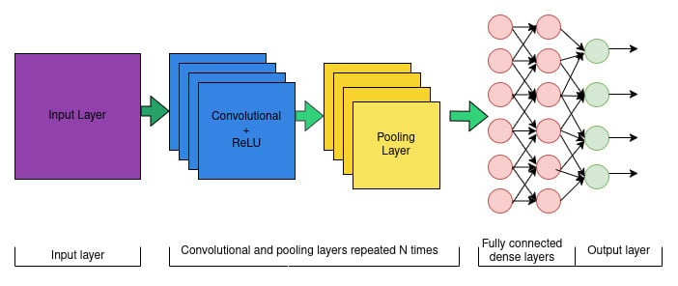
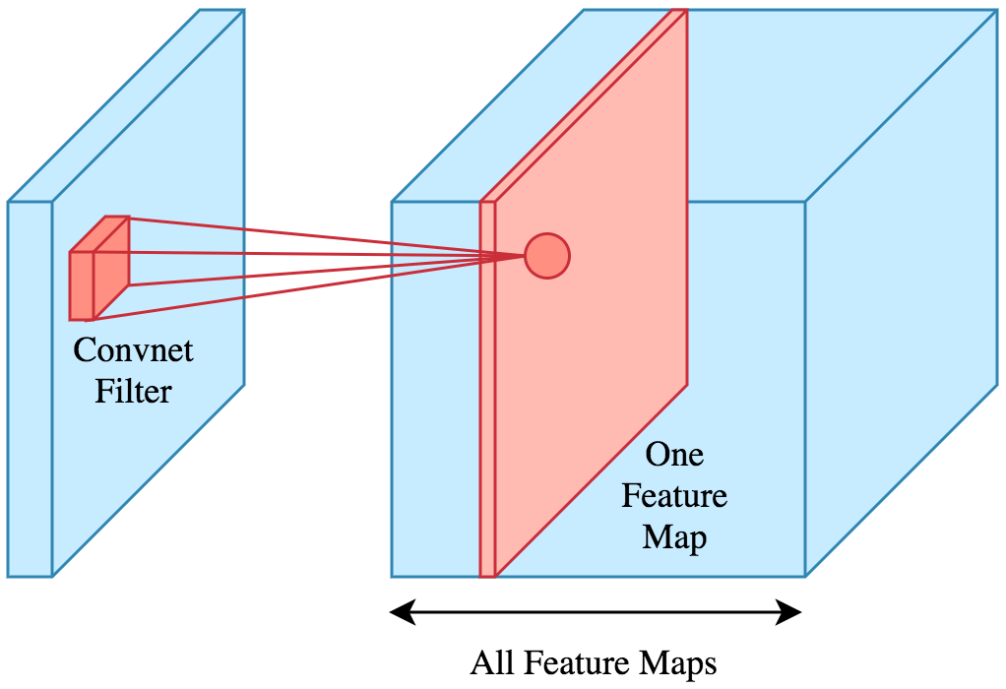
MODEL DESCRIPTION
The input layer to our model contains a number of nodes that correspond to the number of pixels in the input image.
From the input layer the data feeds into the convolutional layer where feature extraction from the image occurs using padding, filtering, and pooling.
In our model we use four static filters and three sets of 3x3 dynamic filters. The static filters are Gaussian, Sobel X, Sobel Y, and Laplacian. The first dynamic set contains 32 filters. The second set contains 64 filters and the third contains 128 filters.
The result of the filtering is a feature map and the computation itself uses dot multiplication shown by formula (1).
Then the ReLU activation function described by formula (2) is applied to the feature map in order to add non-linearity to the features learned.
Then in pooling we use the MaxPooling function that builds a new compressed feature map by selecting a pixel with the largest value inside each area that it slides over.

Slide 10
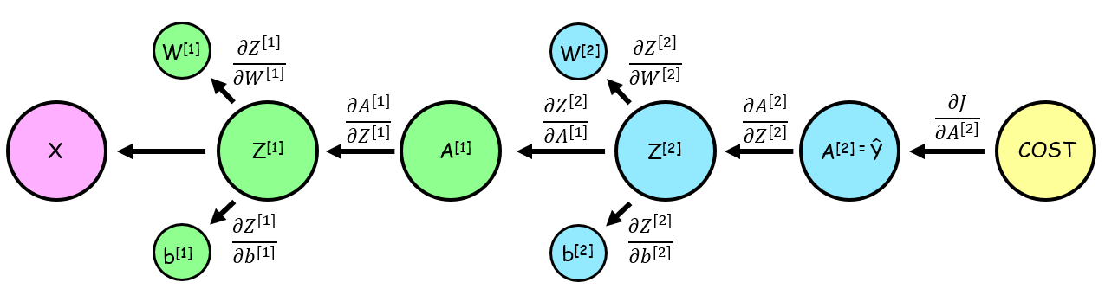
MODEL DESCRIPTION (CONT.)
From the convolutional layer the data is passed to the fully connected layer.
We use two hidden layers containing 256 and 128 neurons that are all connected to every input and every output.
Each neuron takes the input as a vector, computes the result using ReLU activation function described by formula (2), and sends it to every neuron in the output layer.
The resulting output is a vector obtained using the Softmax activation function described by formula (3).
The model goes through training that obtains optimal values for weights and biases through backpropagation.
For efficiency, our model processes input images as batches of 64 at the same time in parallel.
After training our model goes through the validation phase that predicts the classes of images in the validation dataset. The predictions are compared to the image labels to calculate the accuracy.
Finally, model testing on another dataset is performed.

Slide 11
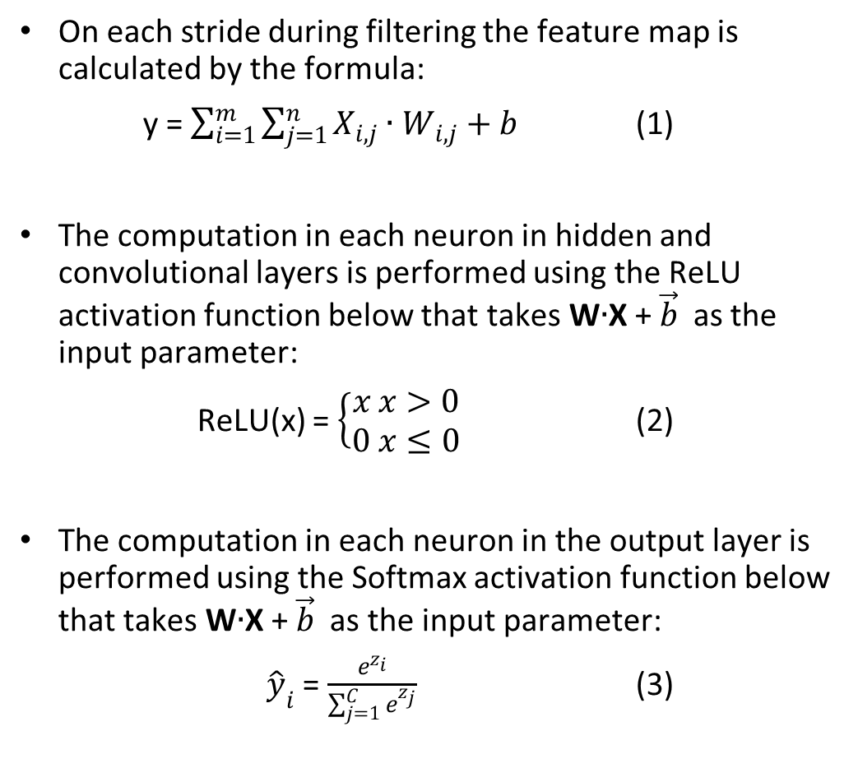

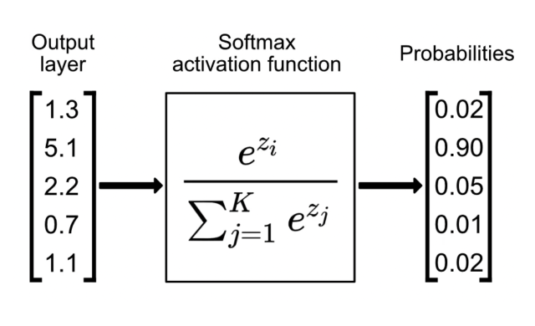
UNDERSTANDING THE FUNCTIONS

Slide 12
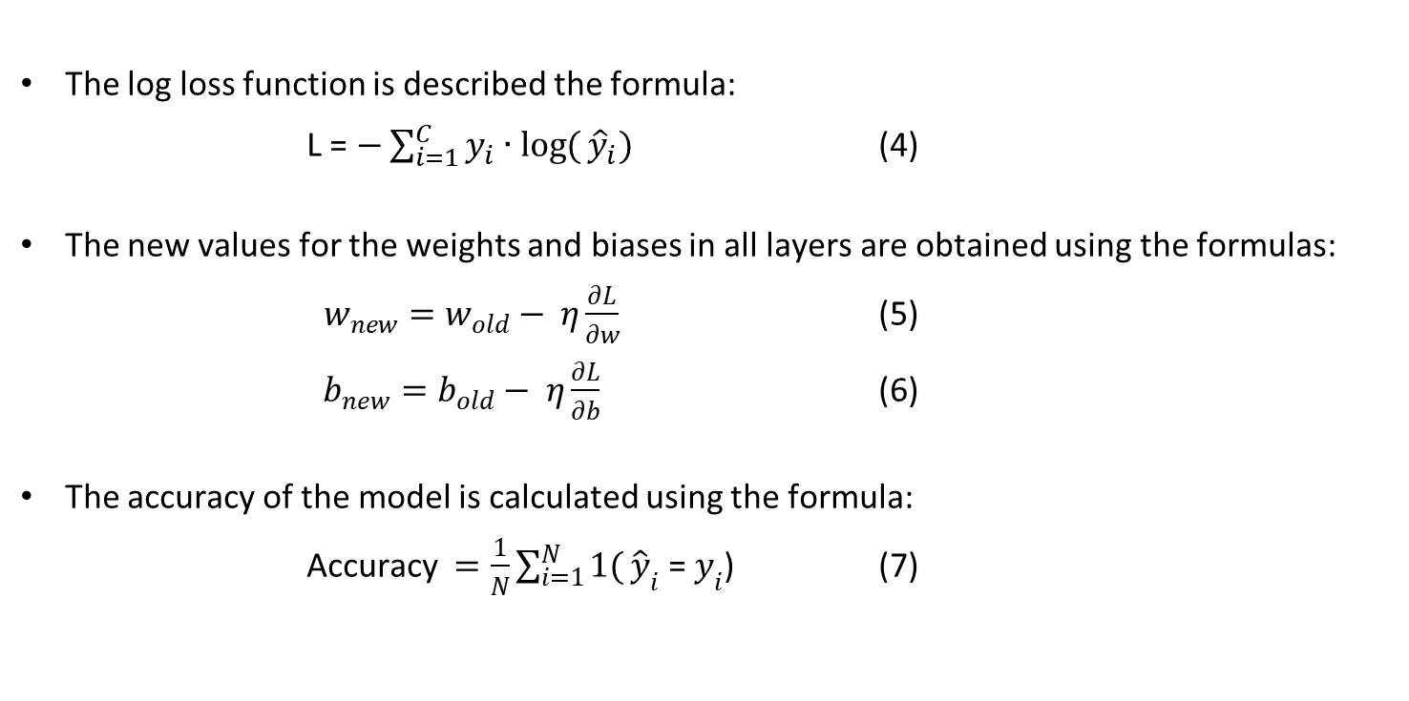
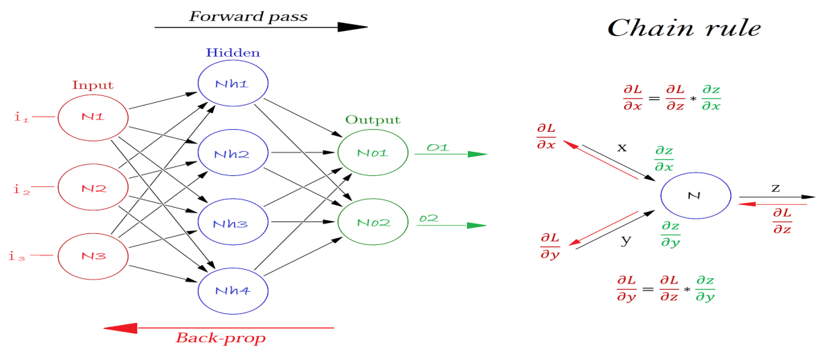
UNDERSTANDING THE FUNCTIONS (CONT.)

Slide 13
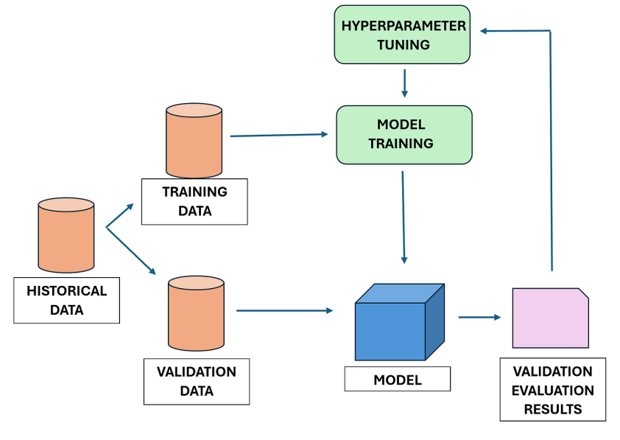
MODEL HYPERPARAMETERS
Our hyperparameters have the following fixed values:
number of neurons in the first hidden layer = 256
number of neurons in the second hidden layer = 128
number of epochs = 15
learning rate = 0.001
batch size = 64
number of filters in the first dynamic convolutional layer = 32,
number of filters in the second dynamic convolutional layer = 64.
number of filters in the second dynamic convolutional layer = 128.

Slide 14
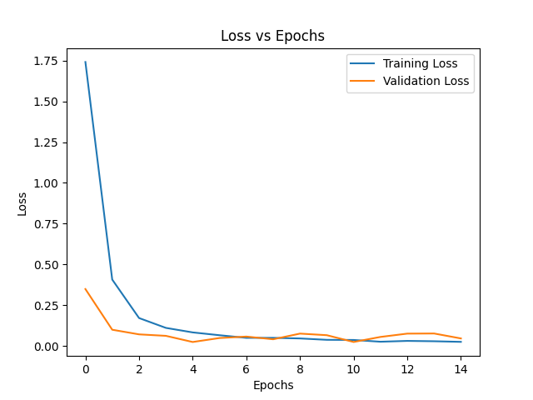
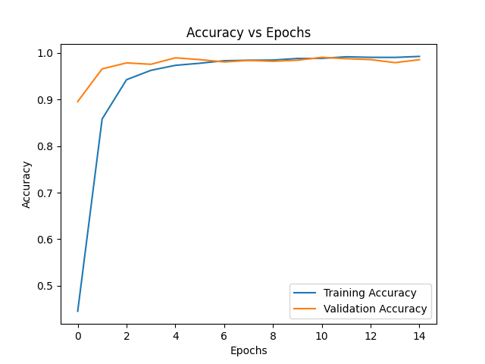
OBTAINED RESULTS (MNIST MODEL)
After 15 iterations the final results are the following:
Training accuracy = 0.9926
Training loss = 0.0249
Validation accuracy = 0.9856
Validation loss = 0.0459
Testing accuracy = 29.2%

Slide 15
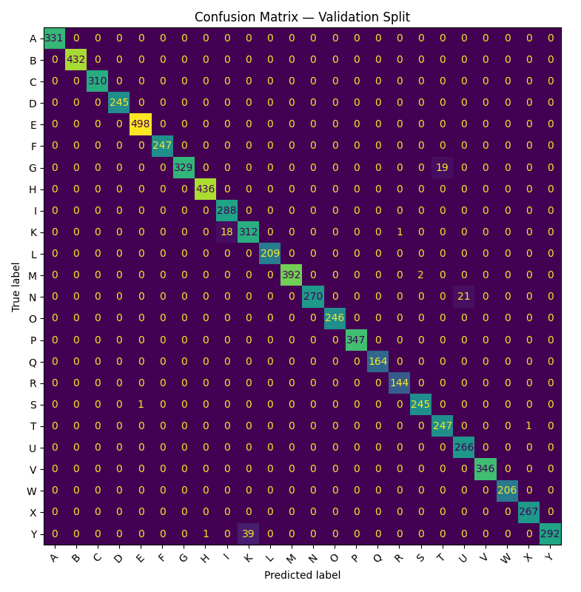
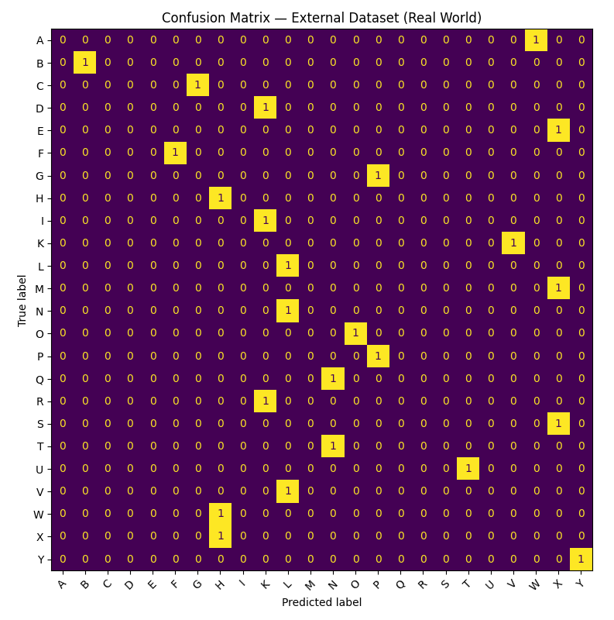
OBTAINED RESULTS (MNIST MODEL)

Slide 16
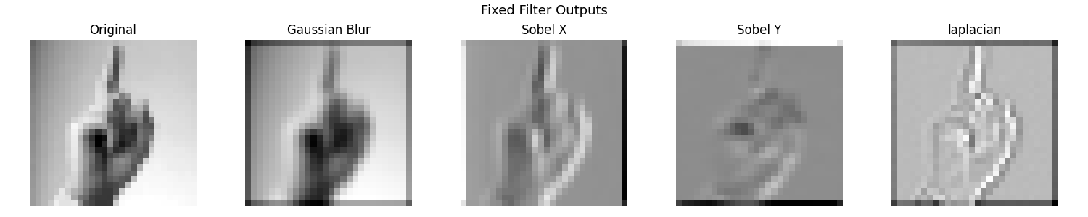
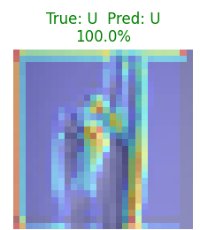
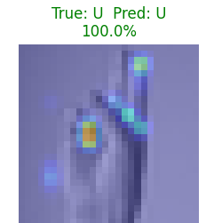
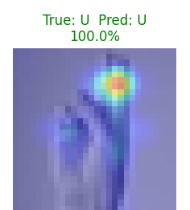
OBTAINED RESULTS (MNIST MODEL)
The features extracted by the filters shown on the feature map and GradCam:
First Dynamic Convolutional Layer
Second Dynamic Convolutional Layer
Third Dynamic Convolutional Layer

Slide 17
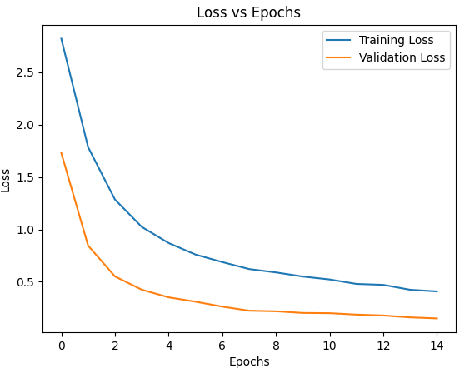
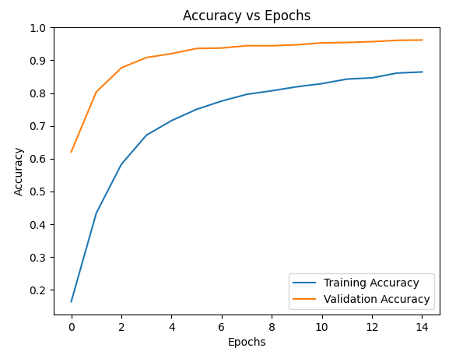
OBTAINED RESULTS (ASL ALPHABET 1000 IMAGES)
After 15 iterations the final results are the following:
Training accuracy = 0.8644
Training loss = 0.4079
Validation accuracy = 0.9617
Validation loss = 0.1503
Testing accuracy = 29.2%

Slide 18
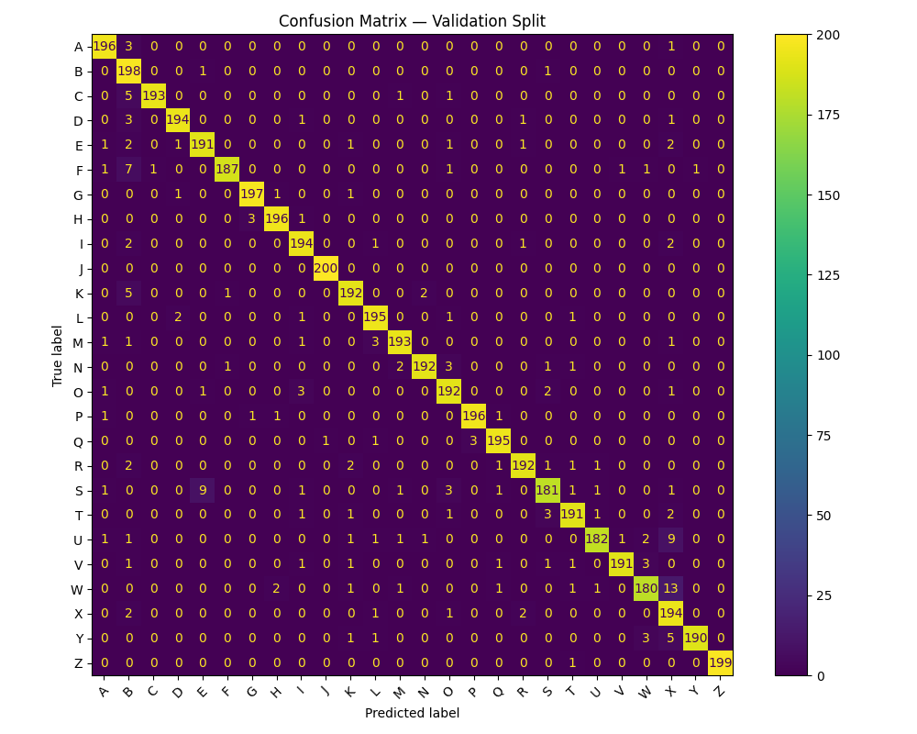
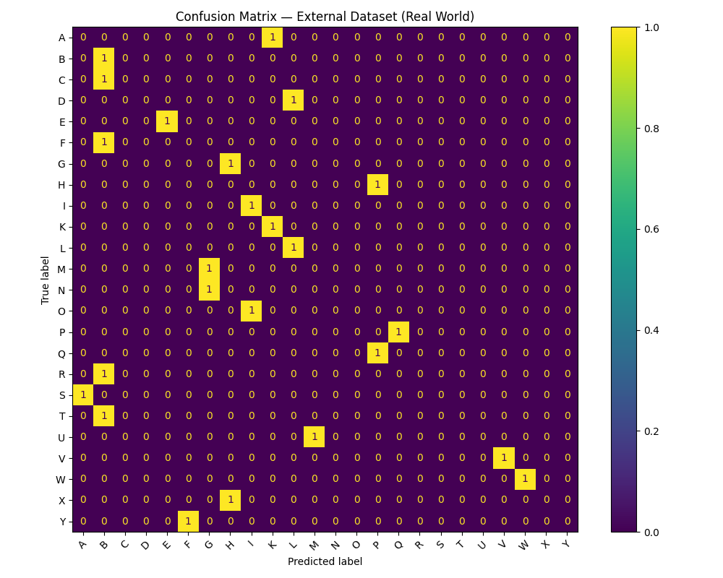
OBTAINED RESULTS (ASL ALPHABET 1000 IMAGES)

Slide 19
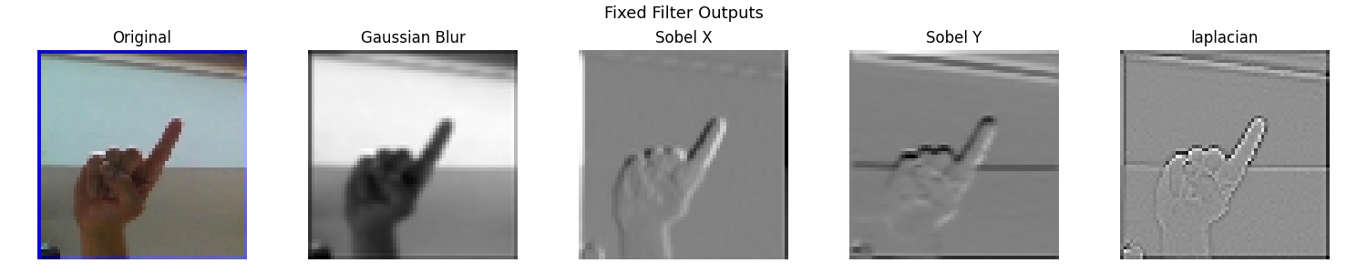
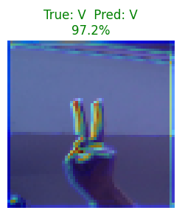
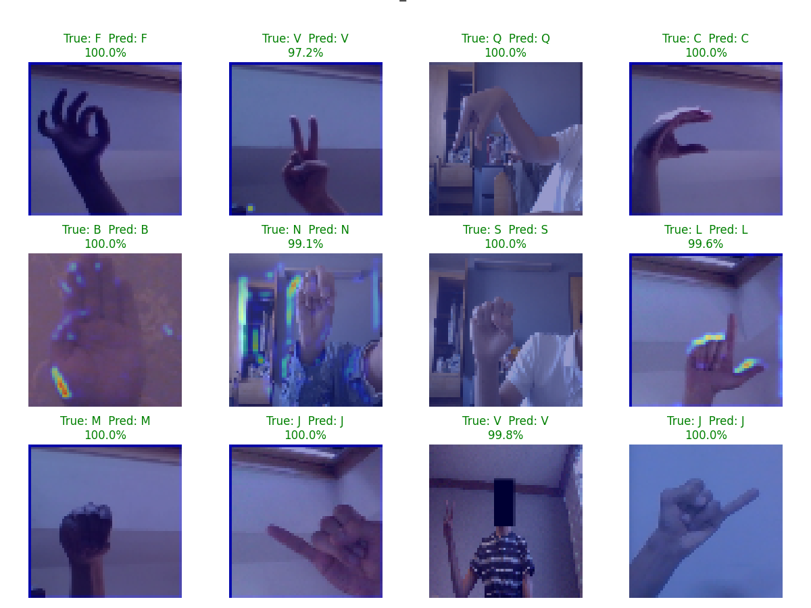
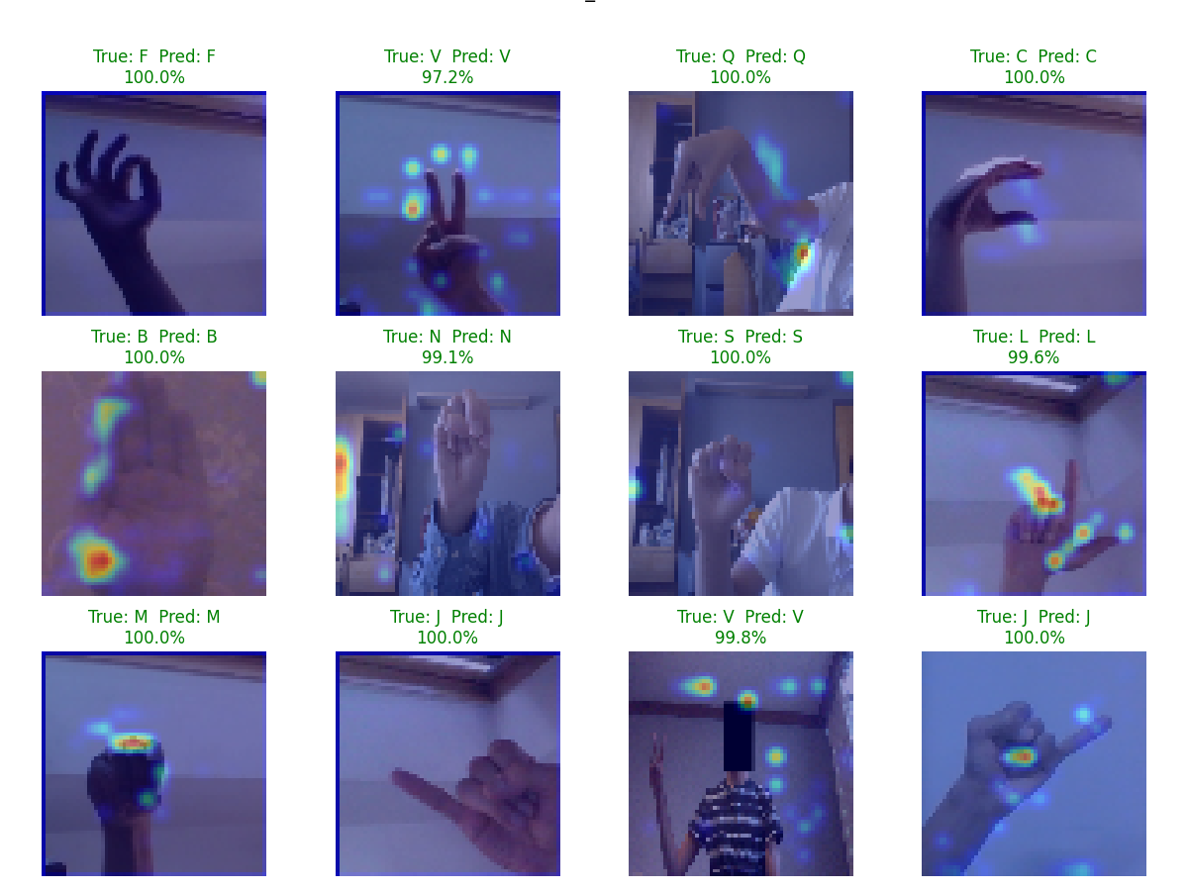
OBTAINED RESULTS (ASL ALPHABET 1000 IMAGES)
The features extracted by the filters shown on the feature map and GradCam:
First Dynamic Convolutional Layer
Second Dynamic Convolutional Layer
Third Dynamic Convolutional Layer

Slide 20
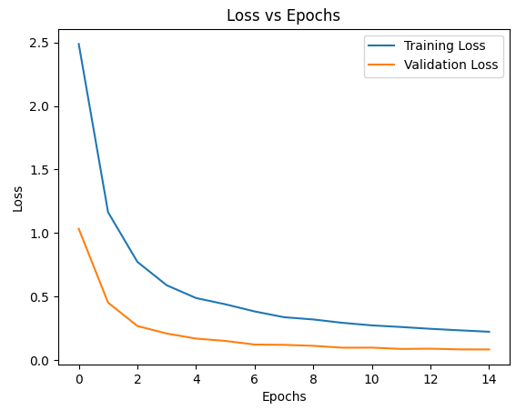
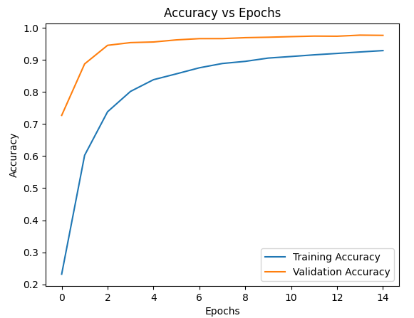
OBTAINED RESULTS (ASL ALPHABET 2000 IMAGES)
After 15 iterations the final results are the following:
Training accuracy = 0.9288
Training loss = 0.2246
Validation accuracy = 0.9763
Validation loss = 0.0855
Testing accuracy = 20.8%

Slide 21

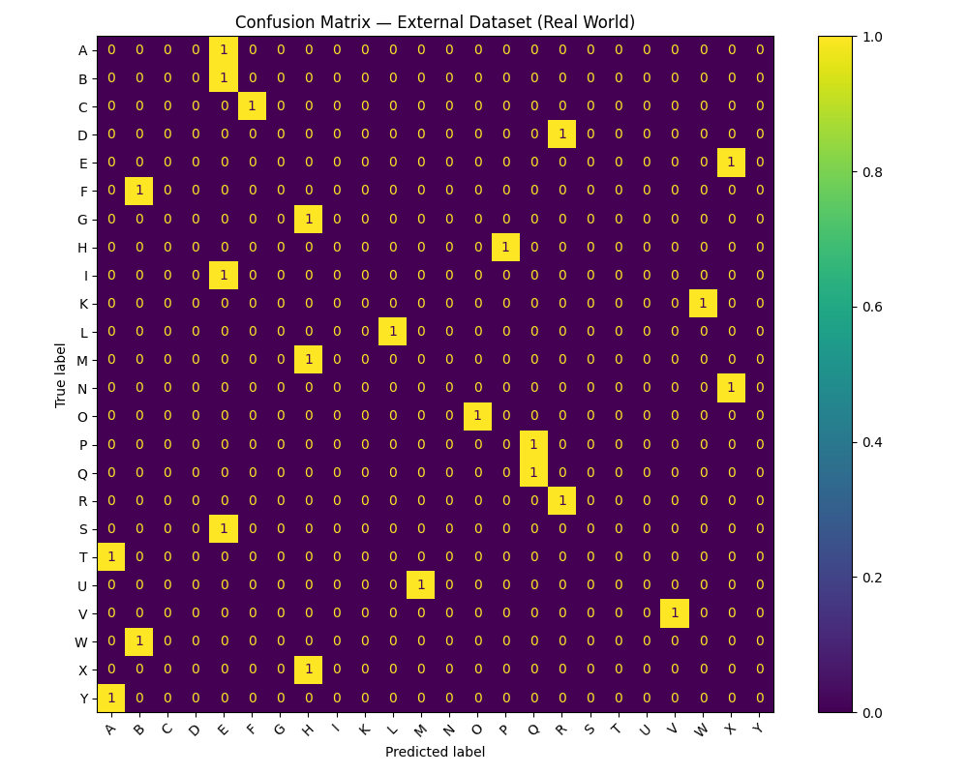
OBTAINED RESULTS (ASL ALPHABET 2000 IMAGES)

Slide 22
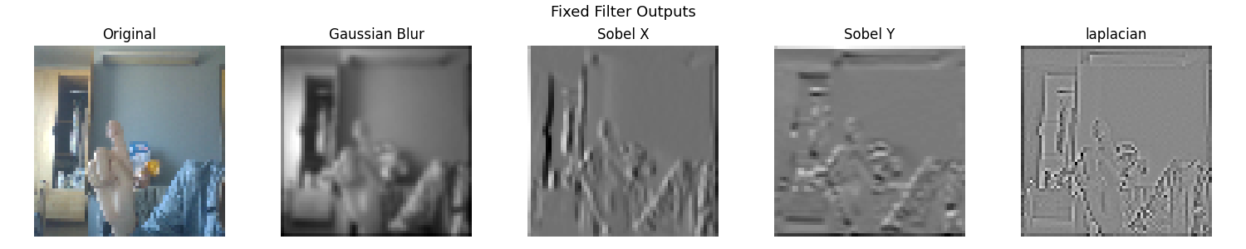
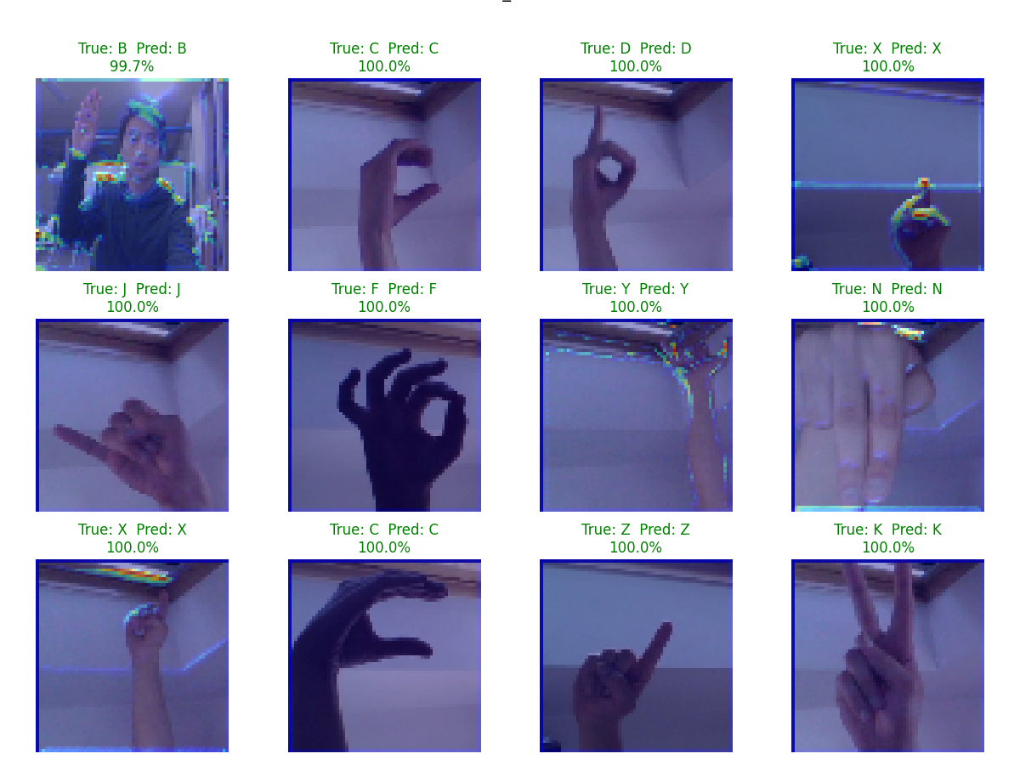
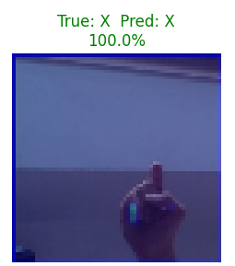
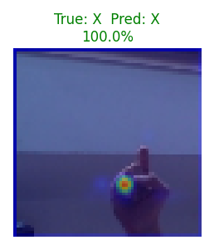
OBTAINED RESULTS (ASL ALPHABET 2000 IMAGES)
The features extracted by the filters shown on the feature map and GradCam:
First Dynamic Convolutional Layer
Second Dynamic Convolutional Layer
Third Dynamic Convolutional Layer

Slide 23
ERROR ANALYSIS
Comparison of the three models:
All three models perform great in training and validation phases with accuracies ranging from 96% to 99%.
All three models show a poor performance during testing phase due to model overfitting on small training datasets.
As the size of the dataset increases, the overfitting increases. This results in ASL Alphabet 2000 Images model showing an even worse performance during testing than the MNIST and ASL Alphabet 1000 Images models.
The reliance on background information leading to poor performance on unseen images was supported by GradCam visualizations that showed objects other than the hand being highlighted.
It is expected that a much larger and more diverse dataset (8,000–10,000 images per class) would improve generalization.
Further testing was limited by memory constraints on available hardware.

Slide 24
COMPARISON TO LITERATURE
Models like “AlexNet” and “VGG-16”, outlined in CNN based feature extraction and classification for sign language [6] described the remarkable achievement of an accuracy rate of up to 98% in sign language classification. This study used static ASL gestures to train the models.
The utilization of Densenet in Comparative Evaluation and Utilization of Convolutional Neural Network Architectures for Irish Sign Language Recognition [8] evaluated CNN as the best architecture as it produced the highest recognition accuracy of 99%. This study was conducted on the ISL-HS dataset containing videos of 6 individuals
The “Recent Advances on Deep Learning for Sign Language Recognition” by Zhang et al. [7] compares SLR performed by different Deep Learning models and highlights CNN models as a good fit for SLR. The accuracies of CNN models in the paper match our validation accuracies of nearly 99%. It is not clear if testing on unseen images was studied. The challenges of SLR using CNN also match the challenges we experienced. The challenges include limited availability of large-scale and diverse datasets, the contradiction between model accuracy and computational power, real-time processing and latency, etc.

Slide 25
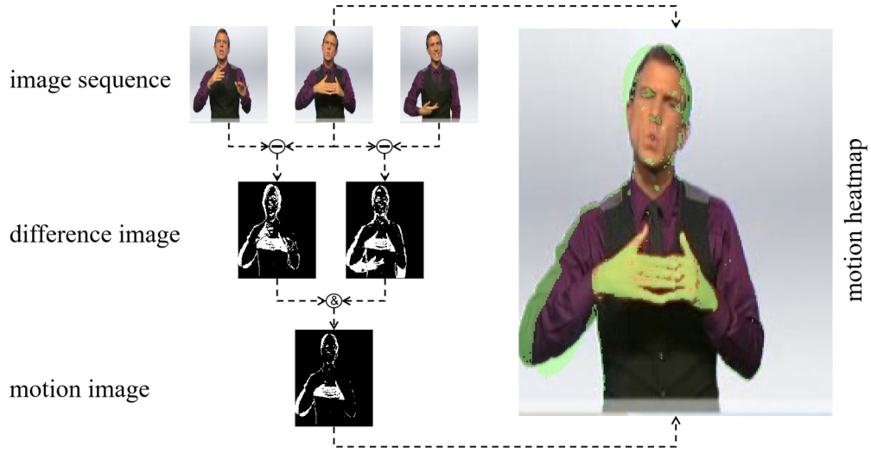
FUTURE WORK
The following planned after the initial model were implemented in the final model:
Addition of static filters – we added Gaussian, Sobel X, Sobel Y, and Laplacian.
Tuning hyperparameters of the model and analyzing their influence on the model’s performance.
Adding a testing phase to our model.
Training and testing the model on different datasets.
A possible future improvement is to apply our model to video streams.

Slide 26
CONCLUSION
Successfully implemented three CNN models, differed by training dataset, capable of recognizing hand sign images for letters with high accuracy.
Results demonstrated good model performance in training and validation and poor performance in testing.
To improve testing performance training datasets of larger sizes are required.
Increasing the training dataset size above 2000 images per letter was not possible due to memory limitations.
Comparison of the three models showed similar results with validation accuracy in the range of 96% to 99%
Increasing the data size from 1000 images per letter to 2000 showed worse testing performance due to increased overfitting.
Features extracted in the convolutional layers were visualized by showing the feature map and using the GradCam technique.
Overall, we are satisfied with our implementation of our CNN models, obtained results, and goals achieved.

Slide 27
CONTRIBUTION
Objectives | Contributor(s)
Topic selection and proposal | Michael and Robert
GitHub repository | Robert
Dataset selections | Michael
CNN architecture | Michael and Robert
Model implementation | Robert
Progress report | Michael and Robert
Model training/validation | Michael
Model improvements | Robert
Testing on unseen images | Michael
Final Report | Michael and Robert

Slide 28
REFERENCES
[1] “Sign Language MNIST,” www.kaggle.com. https://www.kaggle.com/datasets/datamunge/sign-language-mnist/data.
[2] Debashish Sau, “ASL (American Sign Language) Alphabet Dataset,” Kaggle, 2021. [Online]. Available: https://www.kaggle.com/datasets/ debashishsau/aslamerican-sign-language-aplhabet-dataset
[3] F. Islam, “ASL-HG: American Sign Language Hand Gesture Image Dataset,” Mendeley Data, vol. 1, Nov. 2025, doi: https://doi.org/10.17632/j4y5w2c8w9.1.
[4] A. Abdullah, G. A. Amoudi, and H. S. Alghamdi, “Advancements in Sign Language Recognition: A Comprehensive Review and Future Prospects,” IEEE Access, vol. 12, pp. 128871–128895, Jan. 2024, doi: https://doi.org/10.1109/access.2024.3457692.
[5] U. Farooq, M. S. M. Rahim, N. Sabir, A. Hussain, and A. Abid, ‘‘Advances in machine translation for sign language: Approaches, limitations, and challenges,’’ Neural Comput. Appl., vol. 33, no. 21, pp. 14357–14399, Nov. 2021.
[6] A. A. Barbhuiya, R. K. Karsh, and R. Jain, ‘‘CNN based feature extraction and classification for sign language,’’ Multimedia Tools Appl., vol. 80, no. 2, pp. 3051–3069, Jan. 2021.
[7] Y. Zhang and X. Jiang, “Recent Advances on Deep Learning for Sign Language Recognition,” Computer Modeling in Engineering & Sciences, vol. 139, no. 3, pp. 2399–2450, 2024, doi: https://doi.org/10.32604/cmes.2023.045731.
[8] H. M. Sarmad Khan, S. D. Mcloughlin, and I. Murtagh, “Comparative Evaluation and Utilization of Convolutional Neural Network Architectures for Irish Sign Language Recognition,” International Journal of Combinatorial Optimization Problems and Informatics, vol. 16, no. 1, pp. 123–131, Mar. 2025, doi: https://doi.org/10.61467/2007.1558.2025.v16i1.550.
[9] A. A. Barbhuiya, R. K. Karsh, and R. Jain, “CNN based feature extraction and classification for sign language,” Multimedia Tools Appl., vol. 80, no. 2, pp. 3051–3069, 2021, doi: 10.1007/S11042-020-09829-Y.
[10] G. Huang, Z. Liu, L. Van Der Maaten, and K. Q. Weinberger, “Densely connected convolutional networks,” in Proc. 30th IEEE Conf. Comput. Vis. Pattern Recognit. (CVPR), 2017, pp. 2261–2269, doi: 10.1109/CVPR.2017.243.
[11] H. A. Taher and S. R. M. Zeebaree, "A Critical Study of Recent Deep Learning-Based Continuous Sign Language Recognition," The Review of Socionetwork Strategies, vol. 19, no. 1, pp. 131–161, 2025. doi: 10.1007/s12626-025-00180-y.
[12] D. E. Rumelhart, G. E. Hinton, and R. J. Williams, “Learning representations by back-propagating errors,” Nature, vol. 323, no. 6088, pp. 533–536, Oct. 1986, doi: https://doi.org/10.1038/323533a0.

Slide 29
Questions

